Slide 1

SmartHome Pricing Analytics
Leveraging 79 property features — from size and quality to location and age —
to analyze and predict home sale prices across the Ames housing market
AI-ASSISTED DATA ANALYTICS FINAL PROJECT
Data Cleaning • Feature Engineering • Machine Learning • Power BI Dashboard

Slide 2






What We'll Cover
From raw data to a decision-ready dashboard
The Dataset
Cleaning & Feature Engineering
Ames Housing — 1,460 homes, 79 features
Handling missing data, building 8 new features
Exploratory Analysis
Predictive Modeling
Uncovering the patterns behind home prices
5 machine learning models compared
AI-Generated Insights
Interactive Dashboard
Turning results into business recommendations
A 5-page Power BI experience
SmartHome Pricing Analytics
2

Slide 3
Project Overview
An end-to-end AI-assisted data analytics workflow
The Goal
Predict the final sale price of a house using its physical, structural, and locational characteristics — turning raw property records into a model that supports real pricing decisions.
The Approach
A complete analytics lifecycle: clean and prepare the data, engineer meaningful features, explore the patterns, train and compare multiple predictive models, and translate the results into both AI-generated insights and an interactive dashboard.
1,460
Properties analyzed
79
Explanatory features
5
Predictive models compared
SmartHome Pricing Analytics
3

Slide 4
Dataset Snapshot
Ames Housing Dataset — Kaggle: House Prices Advanced Regression Techniques
1,460
89
38
43
Rows
Columns (final)
Numerical features
Categorical features
Target Variable: SalePrice
$180,921
$163,000
$34,900
$755,000
MEAN
MEDIAN
MINIMUM
MAXIMUM
Note: Mean is well above the median — an early signal of high-value outliers (luxury properties) pulling the average upward. Missing values were concentrated in features like pool quality and fireplace quality, most of which are structural (the feature simply doesn't exist for that house) rather than data errors.
SmartHome Pricing Analytics
4

Slide 5
Data Cleaning
Turning raw, messy data into an analysis-ready dataset
1
Missing values
2
Duplicates & empty columns
Structural gaps (e.g. no pool, no garage) filled with a domain-aware placeholder; numeric gaps filled with 0, mode, or median as appropriate
Duplicate rows removed; fully empty columns dropped
3
Text formatting
4
Outliers
Whitespace trimmed from categorical fields for consistency
Reviewed statistically; legitimate luxury properties were kept, not deleted, since they reflect real market variation
SmartHome Pricing Analytics
5

Slide 6
Feature Engineering
Eight new features built to sharpen the model's view of value
New Feature | Derivation | Purpose
HouseAge | YrSold − YearBuilt | Age of the house at sale
YearsSinceRemodel | YrSold − YearRemodAdd | Recency of renovation
TotalSF | Basement + 1st + 2nd floor | True total living area
TotalBathrooms | Weighted sum of all bath columns | Single combined bathroom count
IsRemodeled | Boolean flag | Was the house ever renovated
HasPool / HasGarage / HasFireplace | Boolean flags | Simplified amenity indicators
SmartHome Pricing Analytics
6

Slide 7
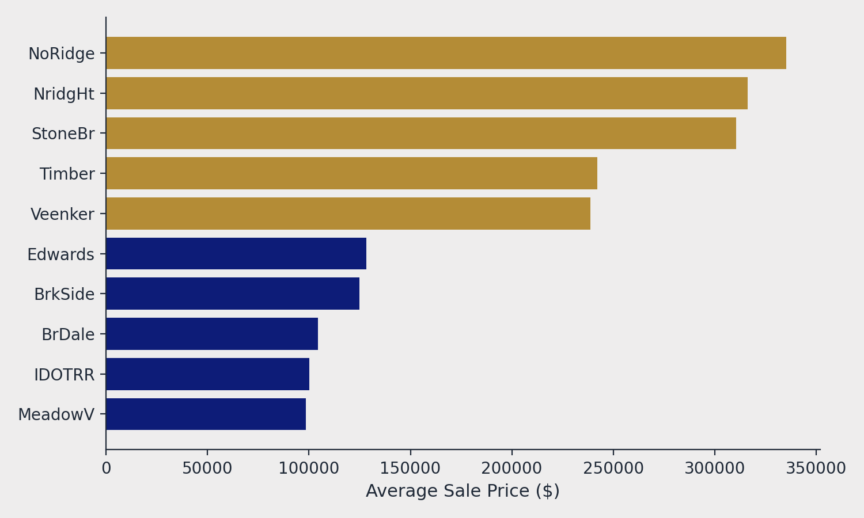
Exploratory Data Analysis
Where you buy matters as much as what you buy
A 3.4x price gap
Average sale price ranges from just $98,576 in MeadowV up to $335,295 in NoRidge — more variation than almost any single physical feature produces.
Takeaway
Location should be treated as a segmentation variable in any pricing strategy — not just another feature.
SmartHome Pricing Analytics
7

Slide 8


Predictive Modeling
Five models, two complementary framings of the same problem
Classification
Regression
Is a house priced above or below the market median?
What is the house's exact predicted sale price?
• Logistic Regression
• Linear Regression
• Decision Tree
• Random Forest
• Support Vector Machine (SVM)
Evaluated using Accuracy and a Confusion Matrix
Evaluated using R² Score, RMSE, and MAE — since it predicts a continuous dollar value rather than a category
SmartHome Pricing Analytics
8

Slide 9
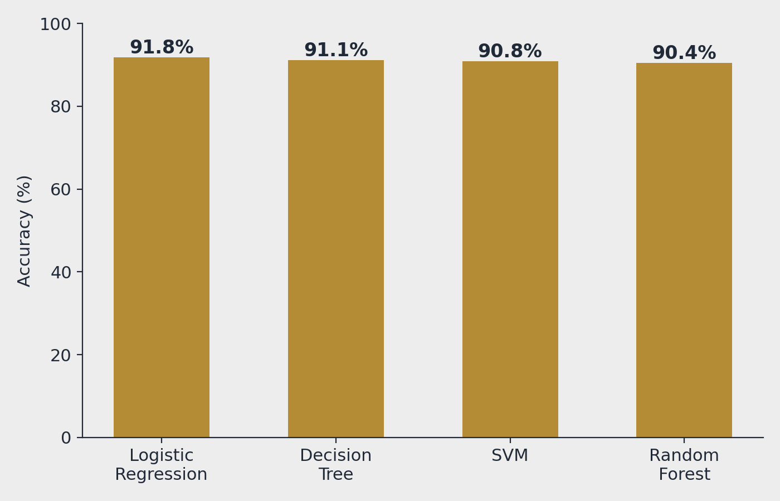
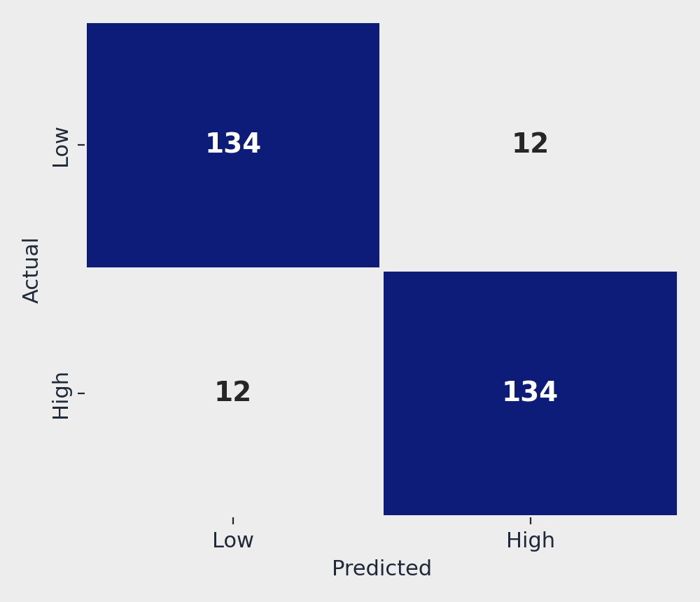
Model Evaluation
Classification accuracy and the strongest performer in detail
Logistic Regression — 91.8% accuracy
Linear Regression: R² = 0.80, RMSE ≈ $39,000 — strong enough for decision support, not a replacement for professional appraisal.
SmartHome Pricing Analytics
9

Slide 10
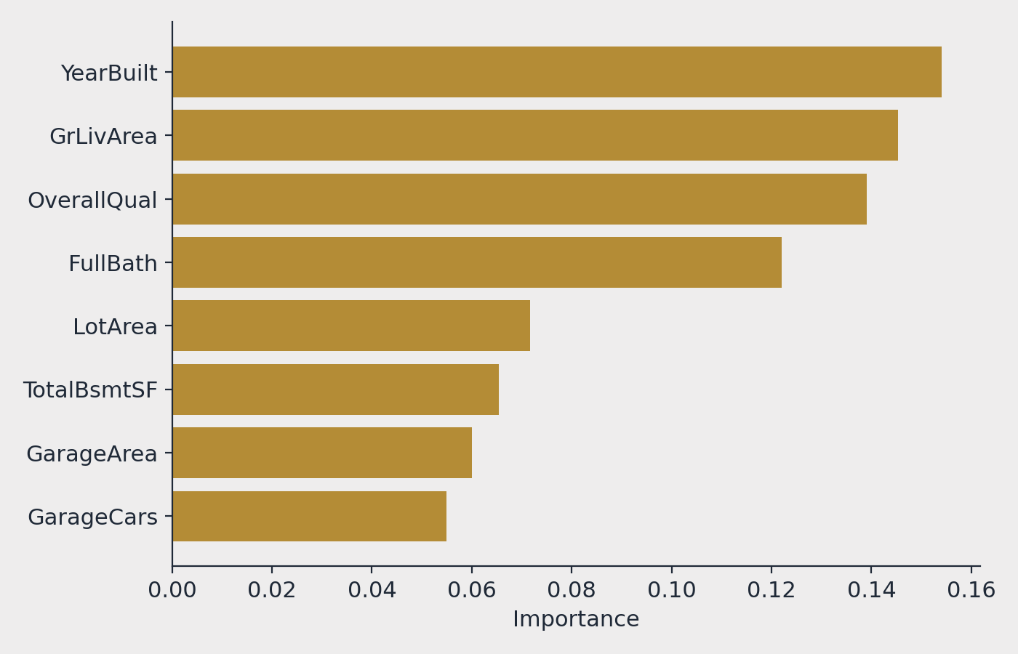
What Drives a House's Price?
Random Forest feature importance across all 13 model inputs
Top 3 predictors
YearBuilt, GrLivArea, and OverallQual — age, size, and build quality — together explain most of the variation the model captures.
Cross-check
This independently confirms the correlation analysis from the EDA stage — the model and the raw statistics agree on what matters most.
SmartHome Pricing Analytics
10

Slide 11




AI-Generated Insights
Turning model output into plain-language findings
Size wins
Recency beats history
Total living area is the single strongest price driver (r = 0.78)
How recently a house was renovated matters far more than whether it was ever renovated
Location creates a 3x gap
Comfort pays off
Average price swings from $98K to $335K purely based on neighborhood
Houses with a fireplace sell for 53% more on average
SmartHome Pricing Analytics
11

Slide 12
Business Recommendations
From insight to action
Prioritize size and layout in renovation investment — TotalSF is the strongest driver of value
1
Time renovations strategically — recency matters more than the fact a renovation happened
2
Use neighborhood as a segmentation variable, not just a feature, given the 3x price gap
3
Highlight fireplaces and similar comfort features prominently in listings
4
Use the model as a second opinion, not a final price — flag properties that deviate from prediction for manual review
5
SmartHome Pricing Analytics
12

Slide 13
Database Architecture
A star schema built for fast, flexible dashboard filtering
Dim_Location
Dim_Garage
1 : 1
1 : 1
via Property_ID
via Property_ID
Fact_Properties
SalePrice • TotalSF • HouseAge
YearBuilt • YrSold • LotArea
Dim_Basement
Dim_Quality
1 : 1
1 : 1
via Property_ID
via Property_ID
SmartHome Pricing Analytics
13

Slide 14
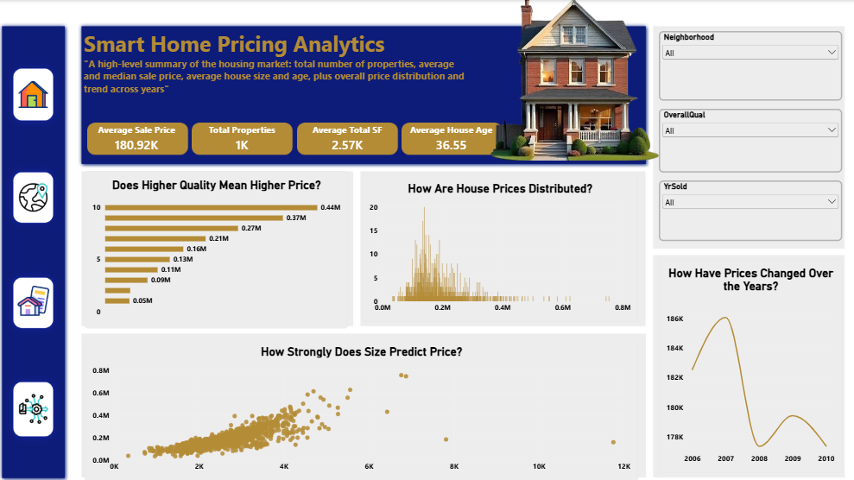
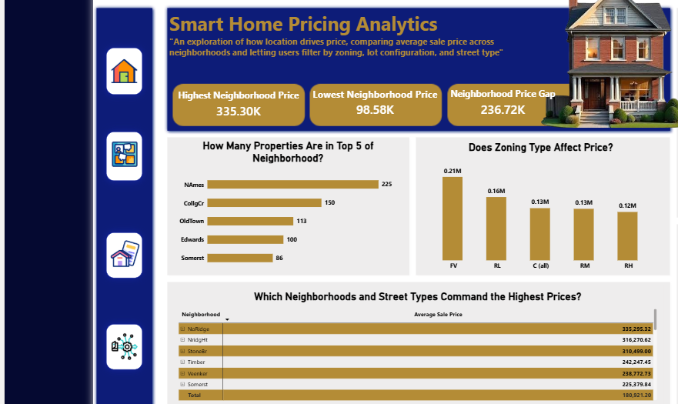
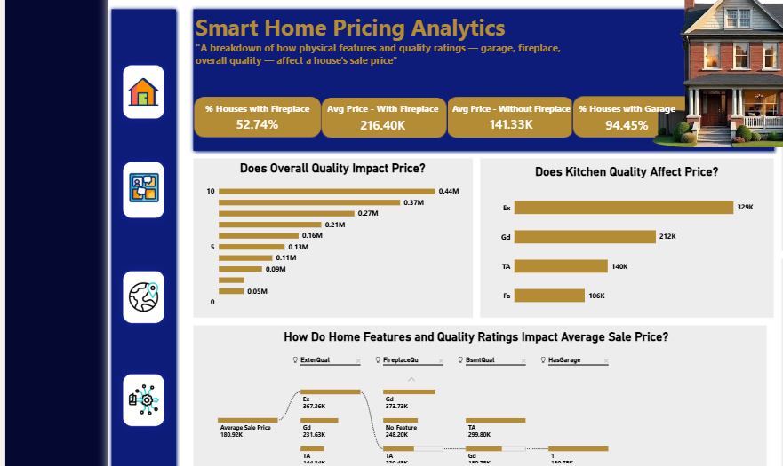
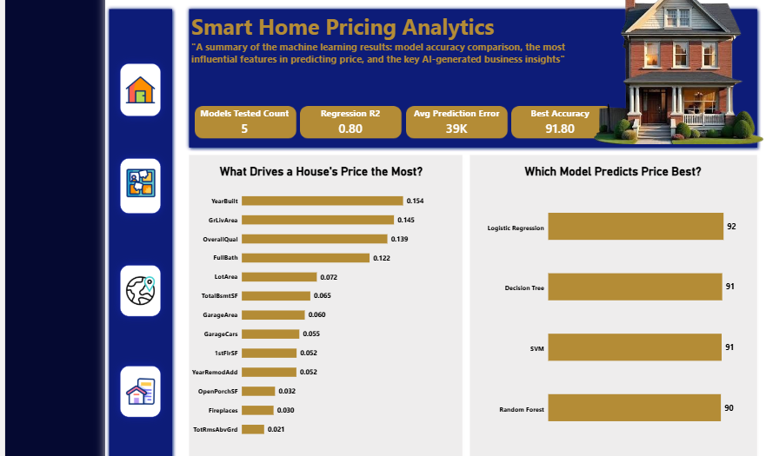
Interactive Dashboard
A 5-page Power BI experience — Home, Overview, Neighborhood, Features, Predictive Insights
Overview
Neighborhood & Location
Features & Quality
Predictive Insights
SmartHome Pricing Analytics
14

Slide 15


Project Value
Full lifecycle
Real AI integration
Strong storytelling
Demonstrates the complete data analytics pipeline, end to end
Generative AI used for cleaning recommendations and insight generation
Raw numbers translated into clear, decision-ready narratives
Thank You
SmartHome Pricing Analytics — AI-Assisted Data Analytics Final Project

